Slide 1
Input Data Selection
Team 2
16102275 Park Hyun Woo
16102391 Aziz Dadabaev
17102063 Lee YooSeok

Slide 2
Context
News Data Preprocessing
New Input Data

Slide 3


News Data Pre-processing
We have from 2021-01-01 to present date news datas.
Firstly we have 210000 words in our news dataset. So we remove keyword of which total frequency is only 1 in our day interval.
After that we have unique word number is 87000. So we need to remove some unnecessary word data.
1. We remove low frequency word data.
The day interval of our data is 312 days. So word that have total frequency number lower than 312 is removed from our dataset.

Slide 4

News Data Pre-processing
2. We remove Korean Stopword from our datasets.
['아이', '시간', '각종', '자신', '시각', '여부', '즉시', '결국', '조금', '다수', '혼자', '이젠', '전자', '단지', '한마디', '남들', '얼마', '이래', '기타', '자기']
These are Stopwords and repeated often in our datasets.
Stop word list come from below reference
(reference : https://www.ranks.nl/stopwords/korean)

Slide 5


News Data Pre-processing
3.Human name Word Delete
Our news data set has human name column that means name included in news data.
We removed human name data from news keyword data set because we determined that it is not necessary for analysis of stock subject.
4.String that contains number Word Delete
We removed that data for analysis only korean word data

Slide 6
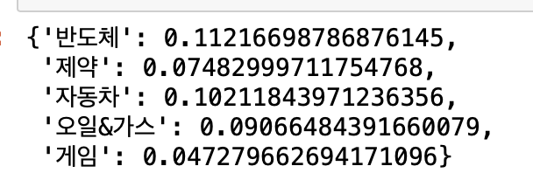
News Data Pre-processing
5. We calculate mutual information by using mutual_info_regressor
We calculated the MI between each sector and word data. And for each sector, only large values were selected based on the MI value of 75% Quantile value.
Above values are 75% quantile value of MI in each sector

Slide 7
News Data Pre-processing
After previous pre-processing procedure,
We can reduce to 4704 words of our news dataset.
And then, we use correlation with each sectors for selecting meaningful word data.

Slide 8
New Input Data of Stock Data
We add volume data of each sector in NYSE (New York Stock Exchange)
In NYSE market, Semiconductor & BIO & CAR & GAS & GAME sector’s trading volume at each date is newly added to our input dataset.
For GAME Sector -> NYSE software sector is used.
The reason why we use that sector, most game stock of NYSE is included in software sectors. So we use that’s trading volume.

Slide 9
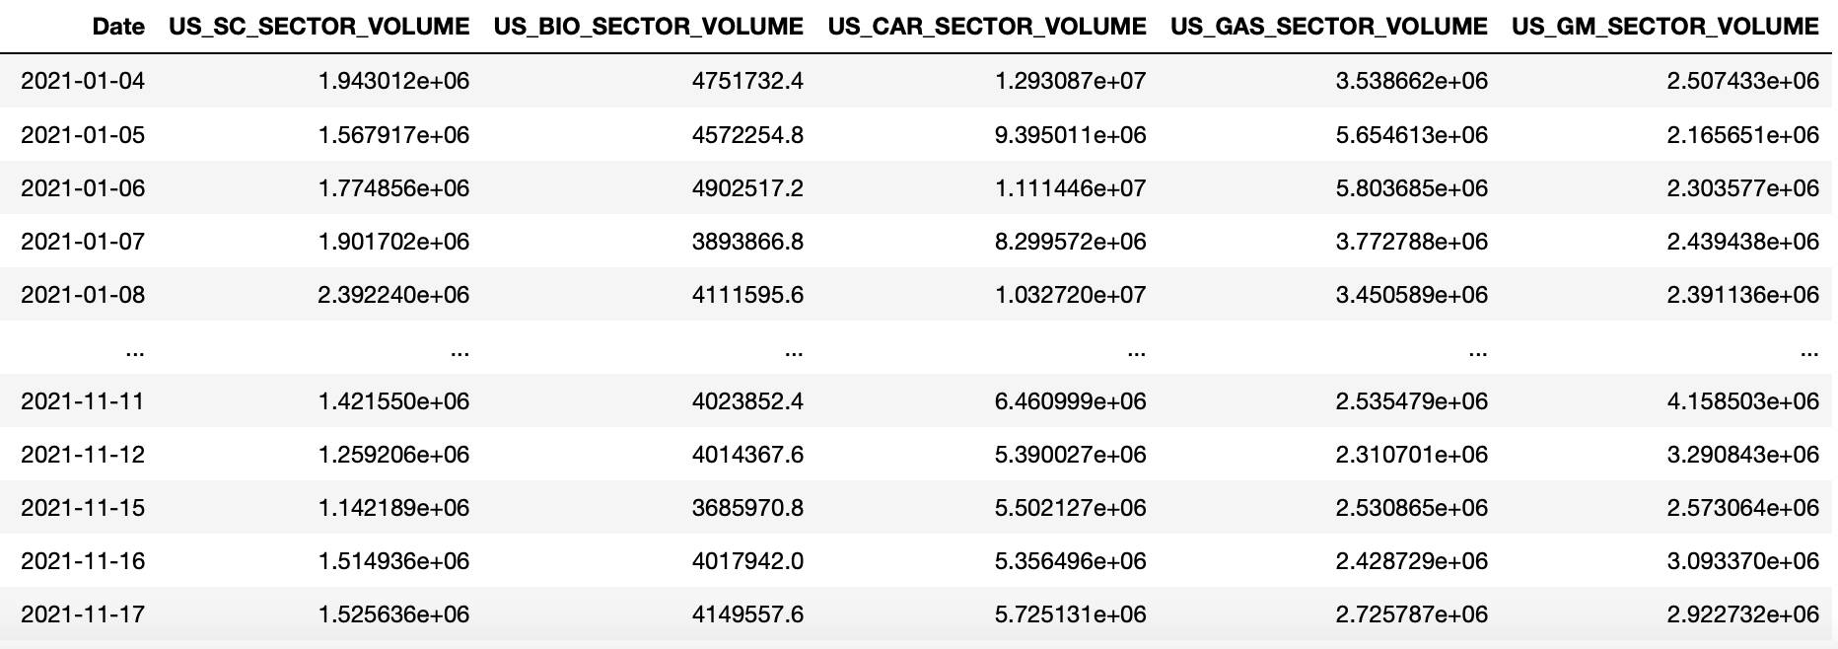
New Input Data of Stock Data

Slide 10
Total Stock Market Input Data
'KBondRate' is korean government bill rate.
'GM_ETF', 'SC_ETF', 'BIO_ETF', 'CAR_ETF' and 'GAS_ETF' are about USA ETF volume data.
'Exchange' and 'Dollar Index' are about currency data with Dollar and Won.
'NG_VOLUME' and 'USO_VOLUME' is for oil and gas future trading volume data.
'US_SC_SECTOR_VOLUME', 'US_BIO_SECTOR_VOLUME', 'US_CAR_SECTOR_VOLUME' , 'US_GAS_SECTOR_VOLUME' and 'US_GM_SECTOR_VOLUME' are NYSE market each sector’s trading volume data.

Slide 11
Thank you for listening
Team 2
16102275 Park Hyun Woo
16102391 Aziz Dadabaev
17102063 Lee YooSeok

